Slide 1
Hola
Like <ExistingApp> but for <NewThing>
Maab Ahmed, Josh Hamilton
Notes:
Ill do the intro

Slide 2
What is Hola?
Tinder for Events
Posting Events
Signing up for Events
Notes:
Maab
Talk about the app, and where you got the idea

Slide 3
Types of Users
Public event planners
Pickup sports
House Parties
Notes:
I got this one

Slide 4
Social Features
Finding events near you
Exposure to smaller events
location is hidden till user is confirmed
Notes:
Maab you take this one

Slide 5
Application Features
Ability to create private/public events
Ability to join events
Ability to customize profile
Notes:
Maab you take this one

Slide 6
Architecture
Model
Connector J
Tomcat
REST
Notes:
Ill talk about the model, you talk about View and Controller

Slide 7
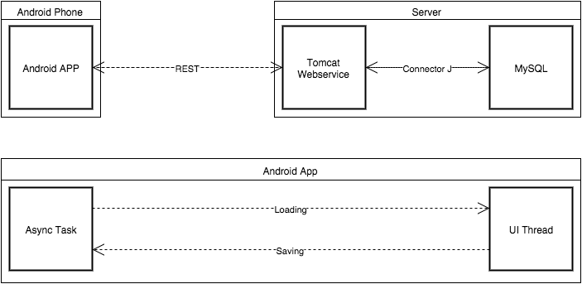
Storage Architecture
Notes:
I got this one

Slide 8
Architecture
View
Controller
Notes:
Ill talk about the model, you talk about View and Controller

Slide 9
Usability/Robustness/Demo
Notes:
What do?

Slide 10
Screenshot

Slide 11
Screenshots

Slide 12
Problems
UI Freezes
Novice Mobile Developers
Connector/J-Android Compatibility
Notes:
Il talk about uI freeze, you talk about others you find

Slide 13
Future
SQL Sanitization
Vulnerable to SQL injection
User can’t input special characters :’(
Security
Encryption
Better Threading
More Async tasks
Social Aspects
Ratings
Privacy
Event types
Facebook Integration
Notes:
Ill talk about SQL Sanitization and Threading, you get the rest

Slide 14
Questions

